Slide 1


DOED MSEIP Summer Research 2021: Analysis of Serena Williams’s Tennis Career
By: Sharrah Allen
Mentor: Dr. Katherine Shoemaker

Slide 2
Analysis of Serena’s Tennis Career
This project aims to analyze the performance of Serena Williams throughout her tennis career by observing her rank over the years, total victories and defeats, tournament type, and number of aces and double faults, to name a few.
This project was done using R and R libraries, such as ggplot and dplyr, to manipulate the data and create meaningful visualizations.
Data was obtained from the following link: https://www.kaggle.com/gmadevs/wta-matches
Process:
Data Cleaning
Brainstorming
Coding and Visualizations
Results:
Visualizations that were created are located on the next slide.

Slide 3
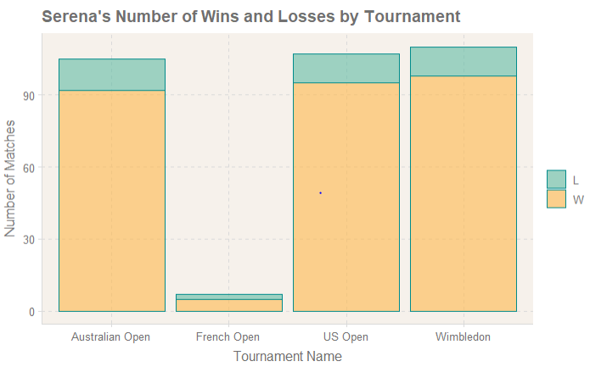
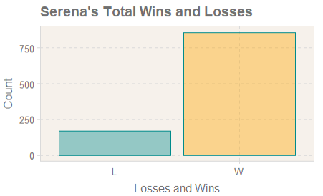
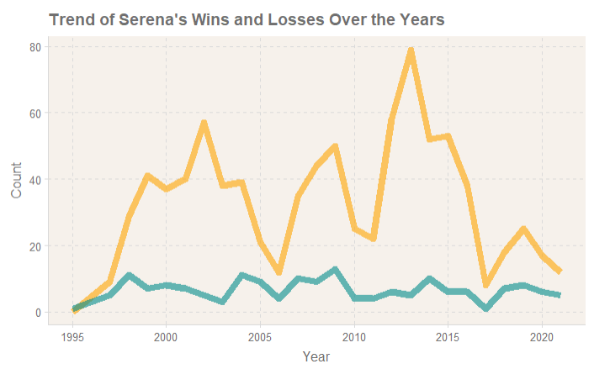
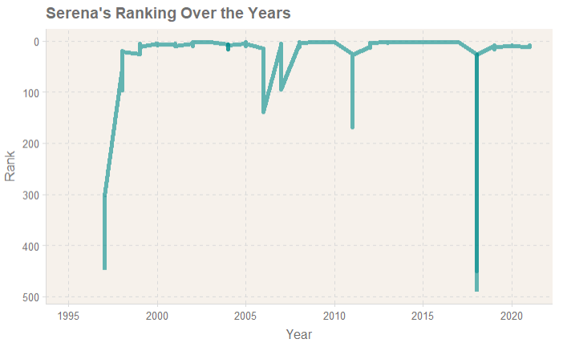
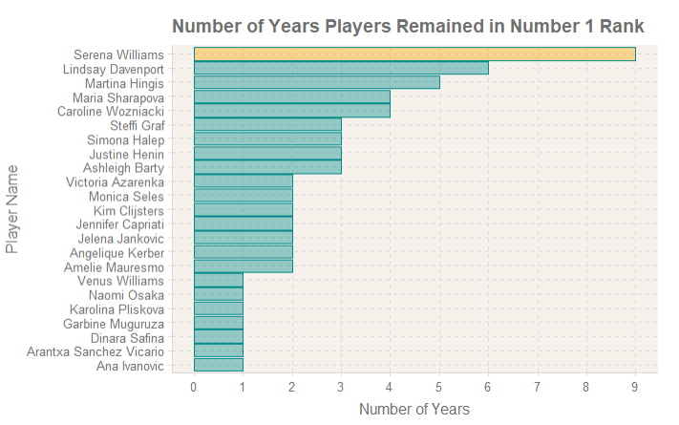
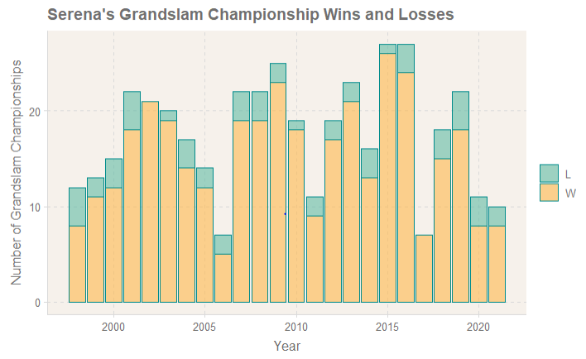
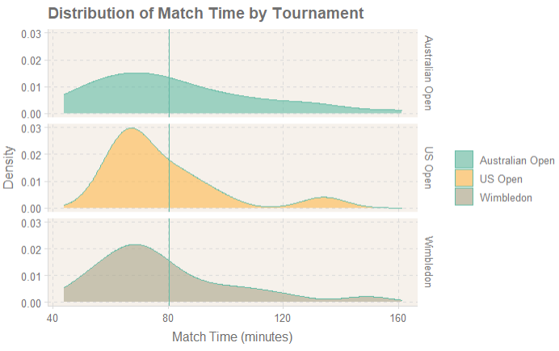
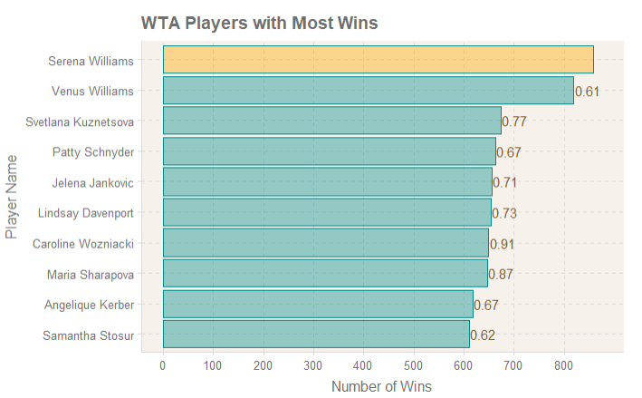
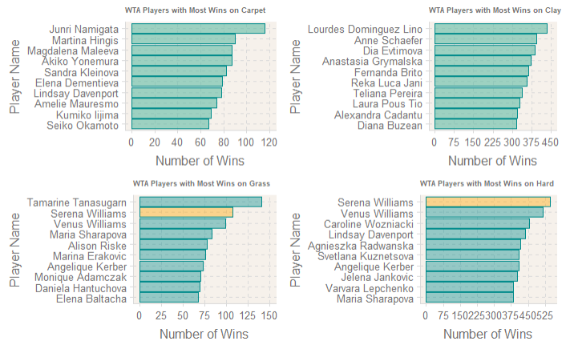
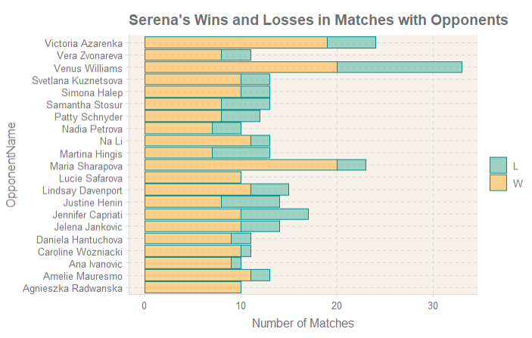
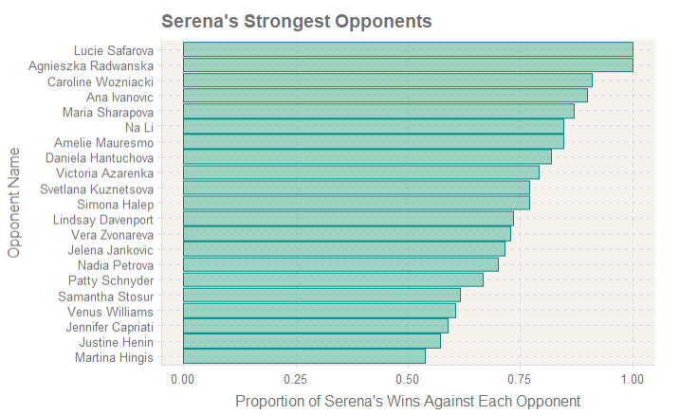
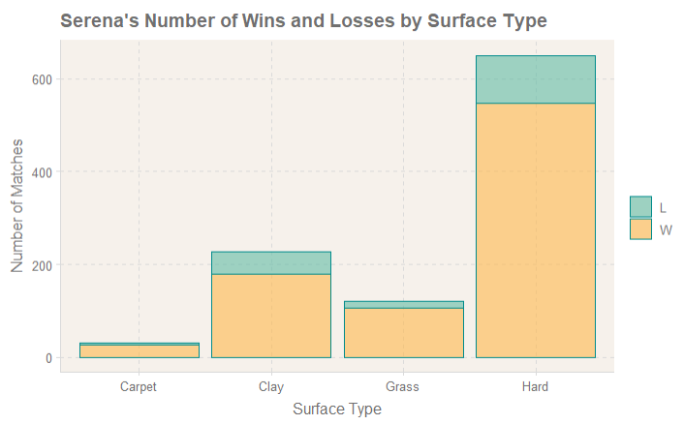
Results

Slide 4
Acknowledgements
Dr. Parker
DOED MSEIP
Dr. Shoemaker

Slide 5
End.

